Slide 1
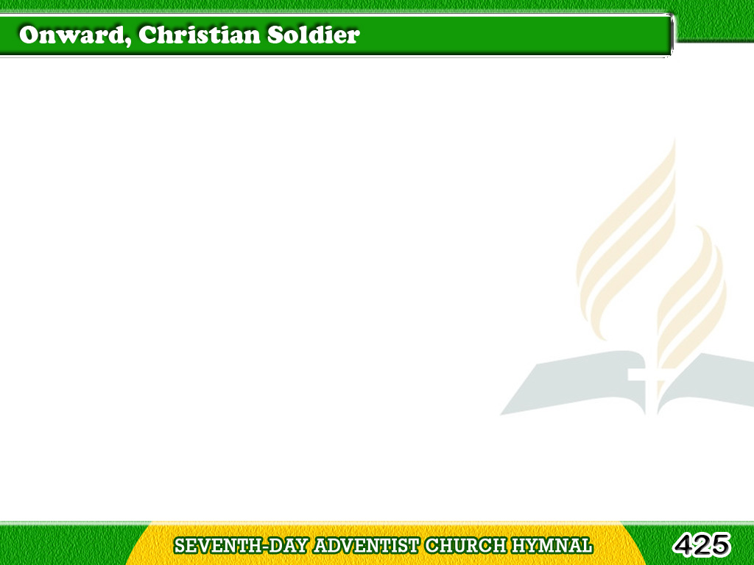
1/4
Onward, Christian soldiers!
Marching as to war,
With the cross of Jesus
Going on before.
Tagalog
Version

Slide 2
1/4
Christ the royal Master,
Leads against the foe;
Forward into battle,
See, His banners go!
Tagalog
Version

Slide 3
1/4
Onward, Christian soldiers!
Marching as to war,
With the cross of Jesus
Going on before.
Tagalog
Version

Slide 4
2/4
Like a mighty army
Moves the church of God;
Christians, we are treading
Where the saints have trod;
Tagalog
Version

Slide 5
2/4
We are not divided,
All one body we,
One in hope and doctrine,
One in charity.
Tagalog
Version

Slide 6
2/4
Onward, Christian soldiers!
Marching as to war,
With the cross of Jesus
Going on before.
Tagalog
Version

Slide 7
3/4
Crowns and thrones
have perished,
Kingdoms rise and wane,
But the church of Jesus
Constant will remain.
Tagalog
Version

Slide 8
3/4
Gates of hell can never
‘Gainst the church prevail;
We have Christ’s own promise,
That can never fail.
Tagalog
Version

Slide 9
3/4
Onward, Christian soldiers!
Marching as to war,
With the cross of Jesus
Going on before.
Tagalog
Version

Slide 10
4/4
Onward, then, ye people!
Join our happy throng,
Blend with ours your voices
In the triumph song;
Tagalog
Version

Slide 11
4/4
Glory, praise, and honor
Unto Christ the King,
this through countless ages
Men and angels sing.
Tagalog
Version

Slide 12
4/4
Onward, Christian soldiers!
Marching as to war,
With the cross of Jesus
Going on before.
Tagalog
Version

